Slide 1


“Social Networking Site”
Submitted by: Souvik Dhara
Submission type : Individual
Name: Social Networking Site
Batch : 12
LMS Id : souvikdhara0001@gmail.com
Program : Axis School Of Fintech
Date: 31/05/2023

Slide 2

Table of contents
Introduction
Project Overview
Architecture Design
User Interface Design
Back-end Development
Front-end Development
Conclusion
Future Work
References

Slide 3
Introduction
Connected: A Web-based Full Stack Social Networking Application
The web-based full stack social networking app designed to foster meaningful connections and engagement.
With Connected, users can register and login to create personalized profiles, post diverse content, search for other users, and easily follow them.

Slide 4
Project Overview
Features:
User Registration and Login/Logout:
Users can create their accounts by registering with their username.
Login functionality allows users to securely access their personalized profiles.
Searching for Other Users:
The app offers a robust search functionality, allowing users to find and connect with other users easily.
Posting Content:
Connected enables users to post content, including text and photos.
Users can express themselves, share experiences, and engage with their followers through their posts.
Following Other Users:
Connect & Engage enables users to follow their favorite individuals or accounts.
By following others, users can stay updated with their posts.
Responsive Element Hiding
The project utilizes media queries to hide certain elements on the page when the viewport width reaches specific breakpoints.

Slide 5
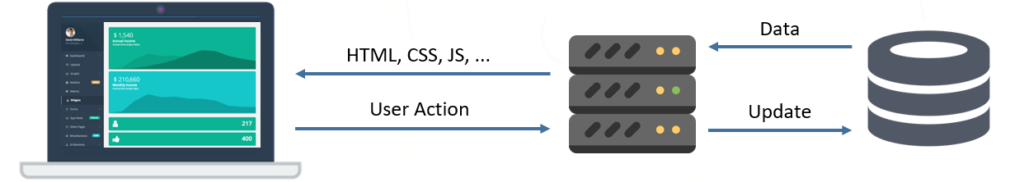
Architecture Design
Frontend
Thymeleaf
Html5
Css
Bootstrap
Backend
SpringBoot
Web
Jpa
Mysql Driver
Lombok
Devtools
Database
MySQL

Slide 6
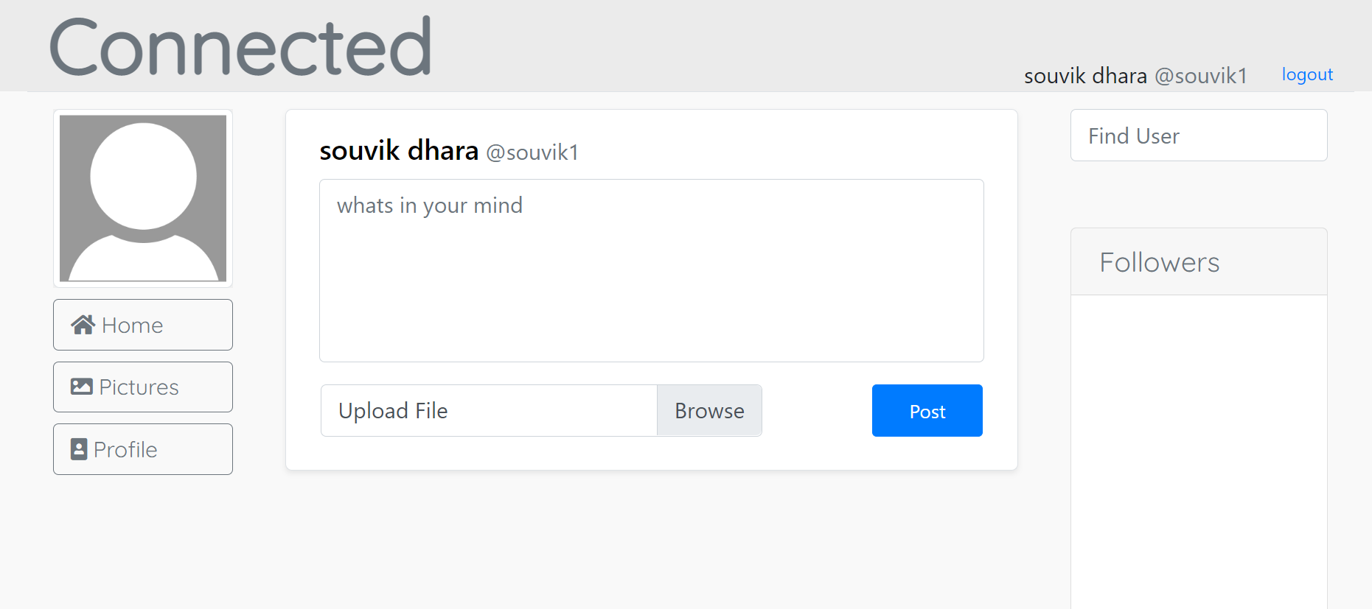
User Interface Design

Slide 7
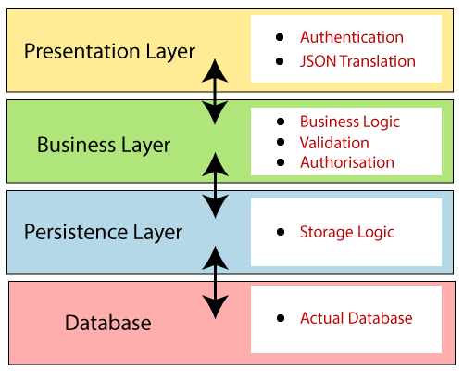
Back-end Development
Spring boot layered architecture
This layer is responsible for handling user interactions and presenting the application's user interface.
It typically includes controllers, views, and other components that
handle HTTP requests and render response
The service layer contains business logic and acts as an intermediary between the presentation layer and the data access layer.
This layer is responsible for interacting with the database or any other data storage mechanism.
It includes repositories, DAOs (Data Access Objects), or JPA
(Java Persistence API) entities.
The database layer is responsible for storing and retrieving data from a database management system (DBMS).

Slide 8
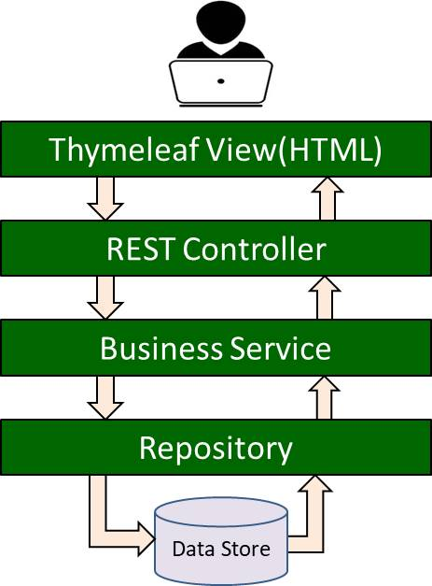
Front-end Development
Thymeleaf is used for generating dynamic HTML pages on the server-side.
HTML defines the structure of the webpage, CSS is used for styling and appearance, and Bootstrap is a CSS framework that provides ready-made styles and components to enhance the design of web pages.

Slide 9
Conclusion
Connected, the innovative web-based full-stack social networking app that brings people together like never before. With Connected, users can seamlessly register, login, post content, search for other users, and even follow their favorite individuals. Our platform empowers individuals to build meaningful connections, share experiences, and foster a sense of community in the digital age.
Features:
User Registration and Login/Logout
Searching for Other Users
Posting Content
Following Other Users
Responsive Element Hiding

Slide 10
Future Work
Future Scope:
Converting to Single Page Application: One potential future scope is to convert the existing application into a single-page application (SPA).
Notification System: Implementing a notification system is another future scope. Notifications can be used to keep users informed about important updates, events, or messages within the application.
Groups and Collaboration: Enhancing the application with group and collaboration features can be a valuable future scope.

Slide 11
References
Spring framework: https://spring.io/projects/spring-framework
Spring boot: https://spring.io/projects/spring-boot
Thymeleaf: https://www.thymeleaf.org/doc/tutorials/2.1/usingthymeleaf.html

Slide 12

l

